Slide 1




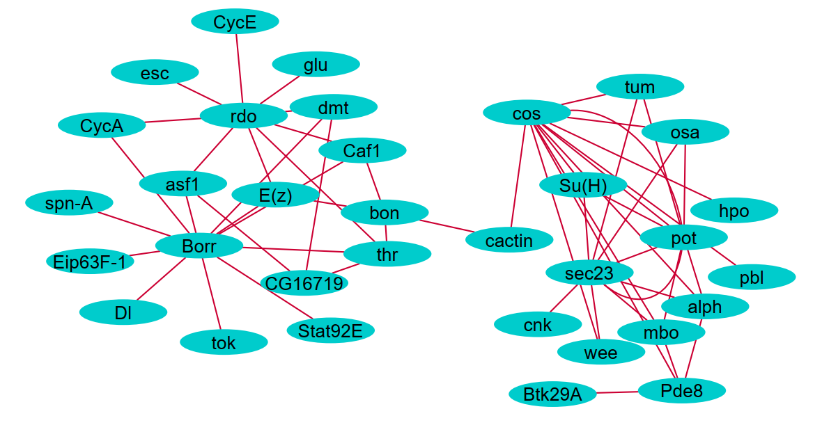
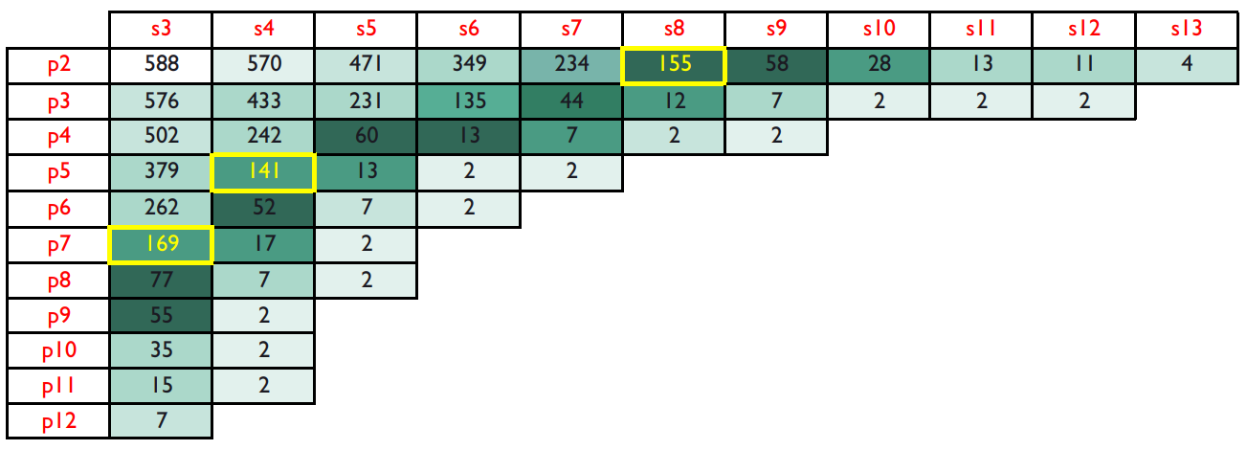



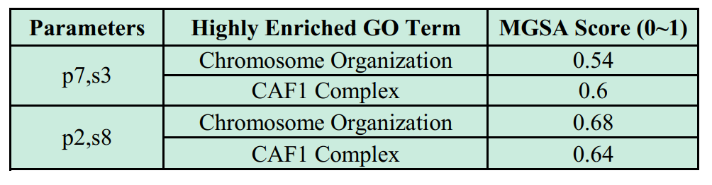


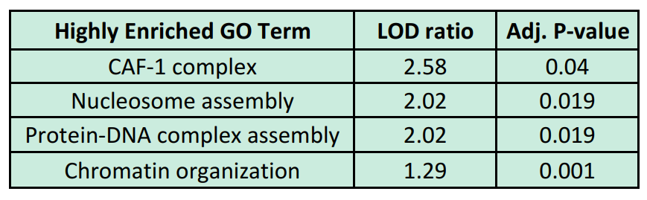
Mining Periodic Subgraph in Drosophila Developmental Networks
Mohammad Shafiqul Islam and Mohammad Rafsun Jany
Dr. Ahsanur Rahman (Supervisor)
Department of Electrical and Computer Engineering
North South University
mdshafiqul.islam@northsouth.edu, jany.mahin@northsouth.edu, ahsanur.rahman@northsouth.edu
Methods
Sample Largest Connected Subgraph (Ex: p2,s8)
Choice of Parameters
Process the dataset of 588 Drosophila Developmental Genes.[2]
Mine periodic subgraph using ListMiner algorithm. [1]
Find the subgraphs that appear periodically in Drosophila Developmental Networks consist of that 588 genes.
Compute numbers of Periodic subgraph Embedding (PSE) based on different period and support.
Most unique genes covered by the PSEs for each combination of parameter (period and supports).
Analyze the largest connected components for each parameter.
P = Periods
S = Supports
Cells = Number of Genes
Parameters are chosen in such a way that Period, support and no. of genes in the PSE is not too low.
Summery of Functional Enrichment
Future Work
MGSA [3] enrichment of the largest connected component in each PSE
Mining periodic pattern in more complex biological developmental network.
Periodic Subgraph
References
2
3
2
3
3
A. Apostolico, M. Barbares, C. Pizzi, Speedup for a periodic subgraph miner, Information Processing Letters, Volume 111, Issue 11, 2011, Pages 521-523.
L. Song, M. Kolar, E. P. Xing; KELLER: estimating time-varying interactions between genes, Bioinformatics, Volume 25, Issue 12, 2009, Pages i128–i136.
S. Bauer, P. N. Robinson, J. Gagneur. "Model-based gene set analysis for Bioconductor." Bioinformatics, volume 27, Issue 13, 2011, pages: 1882-1883.
G. F. Berriz, J. E. Beaver, C. Cenik, M. Tasan, F. P. Roth, "Next generation software for functional trend analysis", Bioinformatics, 2009, Volume 25, Issue 22, pages: 3043-3044.
FuncAssociate [4] enrichment of sorted (by degrees) list of nodes in largest connected component in each PSE
1
1
1
4
5
4
5
T=1
T=2
T=3

